Slide 1
REAL OR FAKE FACE DETECTION
TEAM NAME– INSURGENTS
Team number- 5
Team members:
R. B. Rama krishna
P. Dhanraj nath
B. Sai tejA
aditya Bhardwaj

Slide 2
Introduction
This application is going to examine whether the captured face is original or fake. This is developed using Python and Concept of AI (Artificial Intelligence), as now-a-days AI is the buzzing technology and the future of next generations. Python is the powerful language and best platform for development of these applications which is easy to implement as it has pre-defined libraries which can be accessible for data analysis.

Slide 3
Existing System
As of the past we have the system of face recognition which was a solution for some applications regarding the attendance and security detection but which can bluff in many ways using many fraud methods.

Slide 4
PROPOSED SYSTEM
To overcome the issues of bluffing through face recognition system we have developed this application to detect the face, whether the face is real or fake.

Slide 5
Hardware and software REQUIREMENTS
Hardware Requirements:
The selection of hardware is very important in the existence and proper working of any software, in the selection of hardware, size and the capacity and requirements are also important. They play the vital role.
Hard Disk min40GB
Ram min4GB
Processor Core 2 Duo Min
Web Cam

Slide 6
Software Requirements:
One of the most difficult tasks is that, the selection of software, once system requirement is known that is determining whether a particular software package fits the requirements.
IDE Jupiter notebook
Language Python
Technology AI
Operating system windows7 min/Mac OSX/ Ubuntu

Slide 7
TRAINING & Test
We have Trained with our own data set by taking our pictures so that it identifies the processed image is real or fake.
Test operation is initiated so that we can verify that it can identify the image real or fake

Slide 8
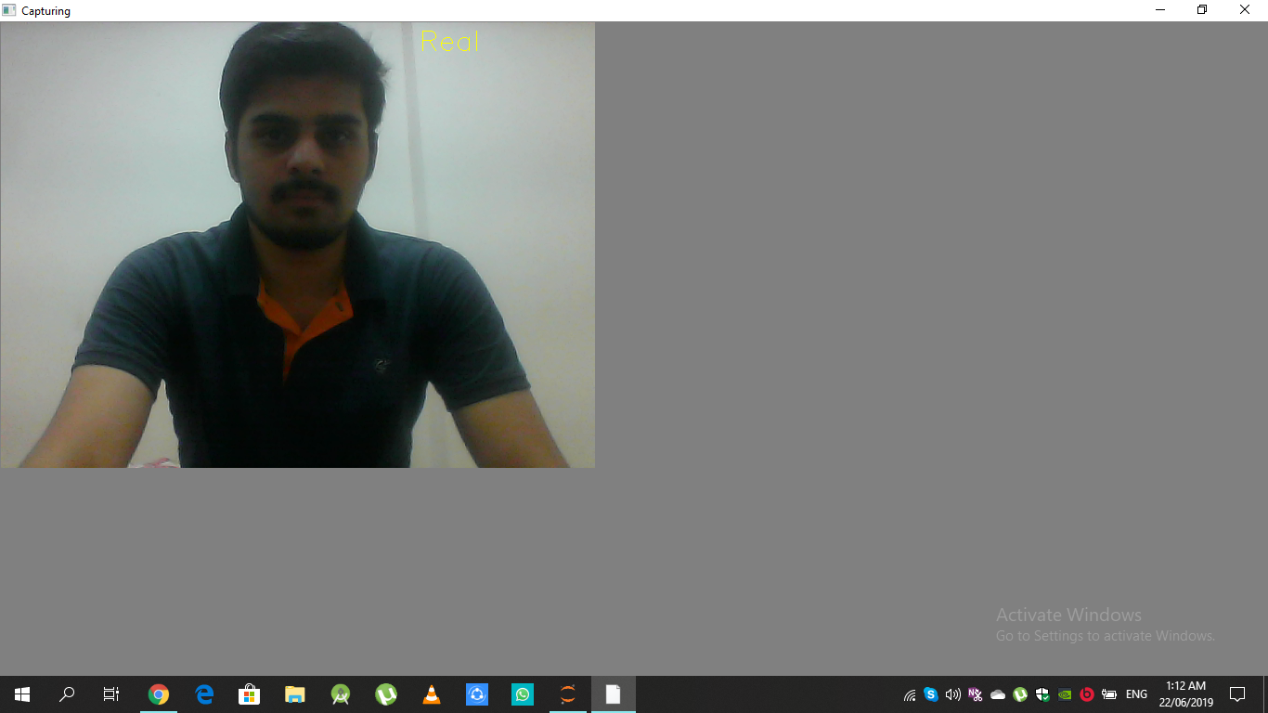
Screenshots
Showing the image whether real or fake

Slide 9
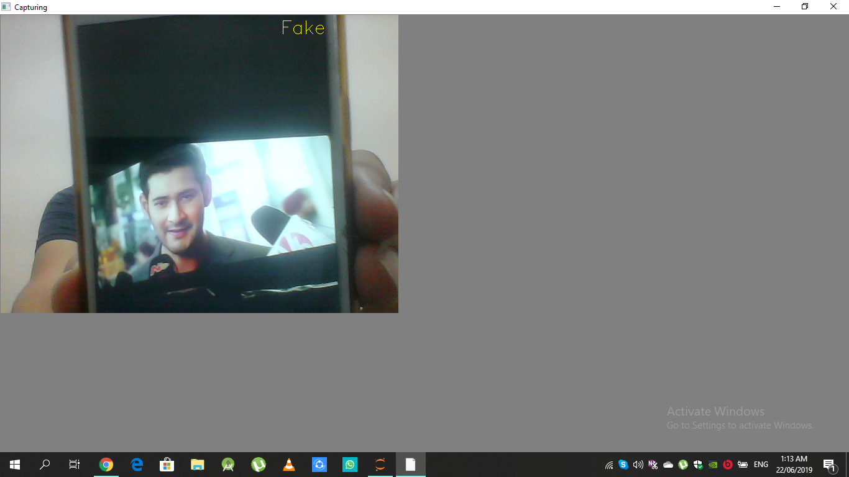

Slide 10
Findings and Suggestions
With the availability of sufficient datasets, our model can be trained to obtain better results.
Also, it can also be developed more efficiently by recording the motions and expressions of the user as said by the application using AI by differentiating each motion to the users.

Slide 11
Conclusion
This application is the better version of existing facial recognition application as it overcomes the issues of bluffing by detecting it as real or fake.
Hence this application can be said as better enhancement of the present existing system.

